Slide 1

Statistics of Radioactive Decay II
RT4220 – Lecture #5
Kedree Proffitt
WSU
09/18/2025

Slide 2
Specific Activity Terminology
Carrier is the STABLE portion of radioactive sample
I-131 radioactive
I-132 stable → carrier
If there is NO stable portion it is carrier-free
Specific activity is the ratio of ACTIVITY OVER MASS of the element present
Carrier-free specific activity is the highest possible specific activity (100% radioactive)
High specific activity is typically desirable
If its injected: less to inject!
If its in a machine: smaller machine!

Slide 3
Practice: Specific Activity
Given two samples of Myoview (brand name Tc-99m) with the following values determine the empty values:
If 10 mCi is required for a gastric clearance study, how many grams are required to be injected? If the samples all have a density of 1 g/mL, how many mLs must be injected?
Sample 1 would require a 10,000 mL or 1 L INJECTION WOW. Sample 2 would require a 1 mL injection wow
Sample | Activity (mCi) | Mass (g) | Spec. Act. (mCi/g)
1 | 0.1 | 100 | 0.001
2 | 200 | 20 | 10

Slide 4
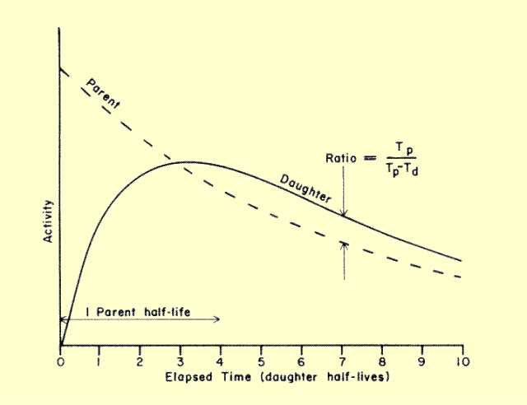

Slide 5

Equilibrium
Shan’t Equivocate this Equilibrium

Slide 6
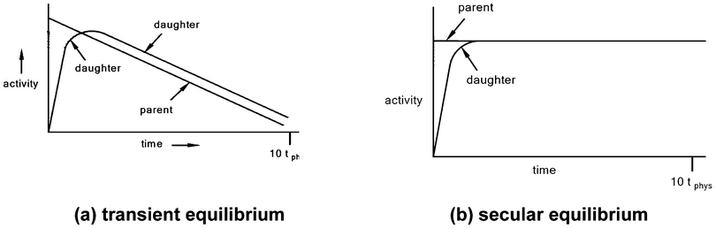
Equilibrium Basics
What happens if the daughter is radioactive?
They decay at different rates → a race!
This leads us to equilibria, three types:
Secular: Half-life of parent >>> daughter’s
Transient: Half-life of parent > daughter’s
No Equilibrium: Half-life of parent <= daughter’s

Slide 7
Secular Equilibrium
If the parent half-life is much longer than the daughter half-life, then the equilibrium established is called secular equilibrium
The activity of the daughter closely matches the parent because there is a bottleneck
Not enough production
Much consumption
Seize the means

Slide 8
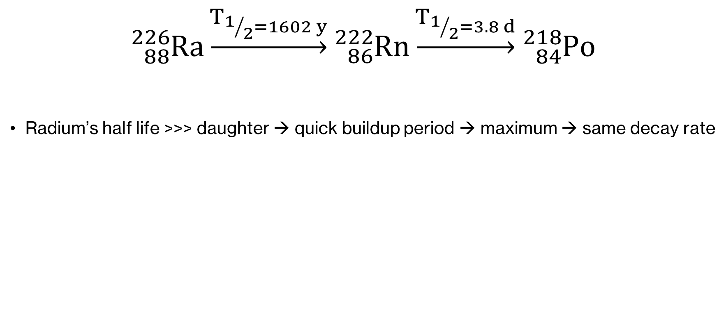
Secular Equilibrium Example
$${}_{88}^{226}{Ra}\underset{→}{T_{1/2=1602 y}}{}_{86}^{222}{Rn}\underset{→}{T_{1/2=3.8 d}}{}_{84}^{218}{Po}$$
Radium’s half life >>> daughter → quick buildup period → maximum → same decay rate

Slide 9
Transient Equilibrium
If the half-life of the parent is longer than the daughter half-life then the equilibrium established is called transient equilibrium
After some maximum where equilibrium occurs (rate of production = rate of consumption) the RATIO of parent:daughter activity becomes CONSTANT
The decay rate of the daughter is dependent upon the decay rate of the parent

Slide 10
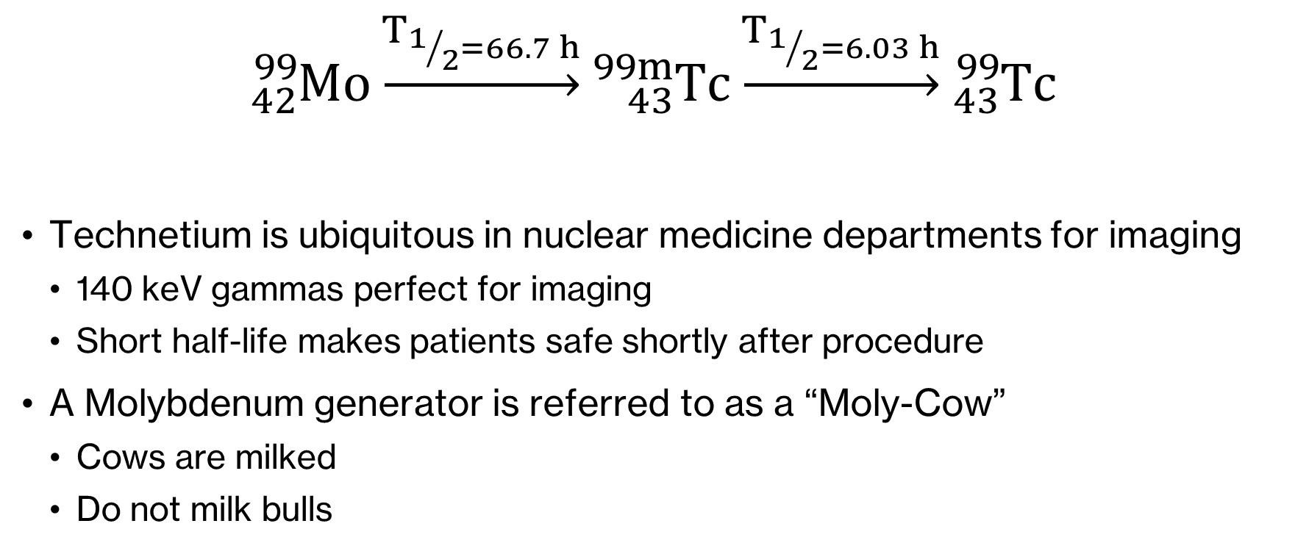
Transient Equilibrium Example
$${}_{42}^{99}{Mo}\underset{→}{T_{1/2=66.7 h}}{}_{43}^{99m}{Tc}\underset{→}{T_{1/2=6.03 h}}{}_{43}^{99}{Tc}$$
Technetium is ubiquitous in nuclear medicine departments for imaging
140 keV gammas perfect for imaging
Short half-life makes patients safe shortly after procedure
A Molybdenum generator is referred to as a “Moly-Cow”
Cows are milked
Do not milk bulls

Slide 11
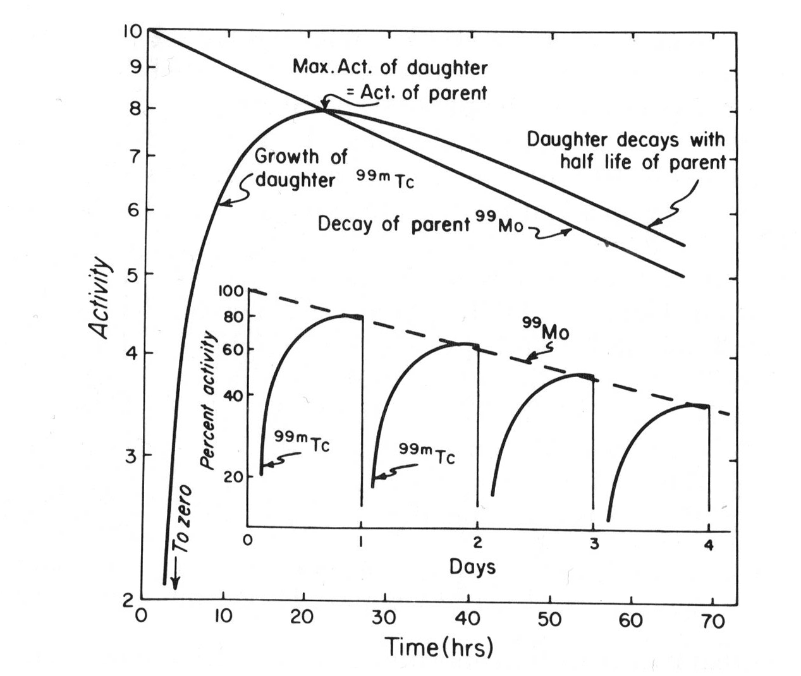
Transient Equilibrium Example Plot
At the right is a plot of the activity inside the Moly-Cow
Pattern of transient equilibrium is apparent, obfuscated by the milking process
Hospitals typically have their own Moly Cow
Time for maximum activity is large compared to the half-life

Slide 12
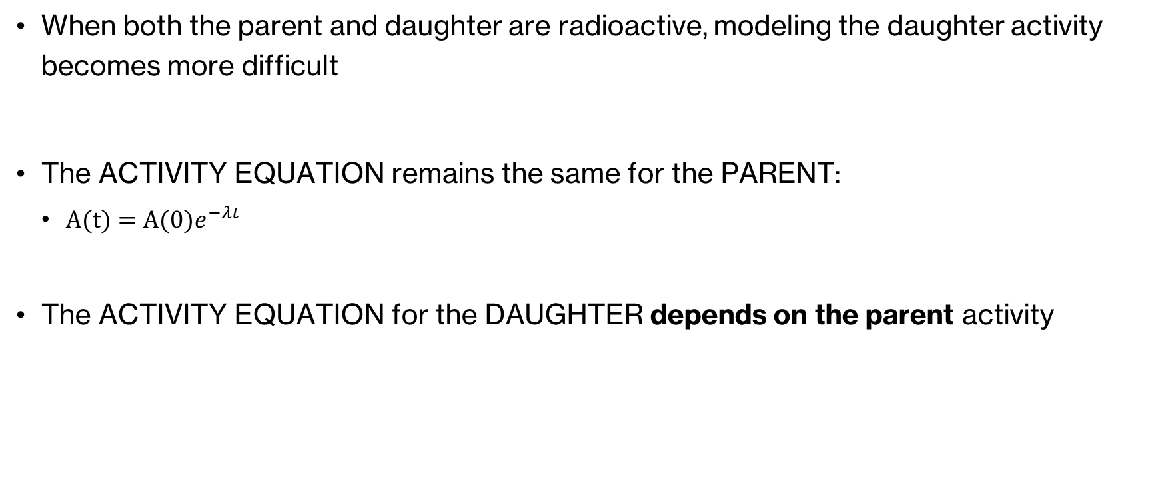
Parent-Daughter Dual Decay
When both the parent and daughter are radioactive, modeling the daughter activity becomes more difficult
The ACTIVITY EQUATION remains the same for the PARENT:
$A(t)=A(0)e^{−λt}$
The ACTIVITY EQUATION for the DAUGHTER depends on the parent activity

Slide 13
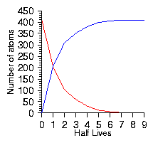
No Equilibrium
At no point is the daughter production/decay rates equivalent
Daughter activity will rise as it decays slower than the parent
Parent half-life < Daughter half-life
Daughter production rate < Daughter decay rate
Parent
Daughter

Slide 14
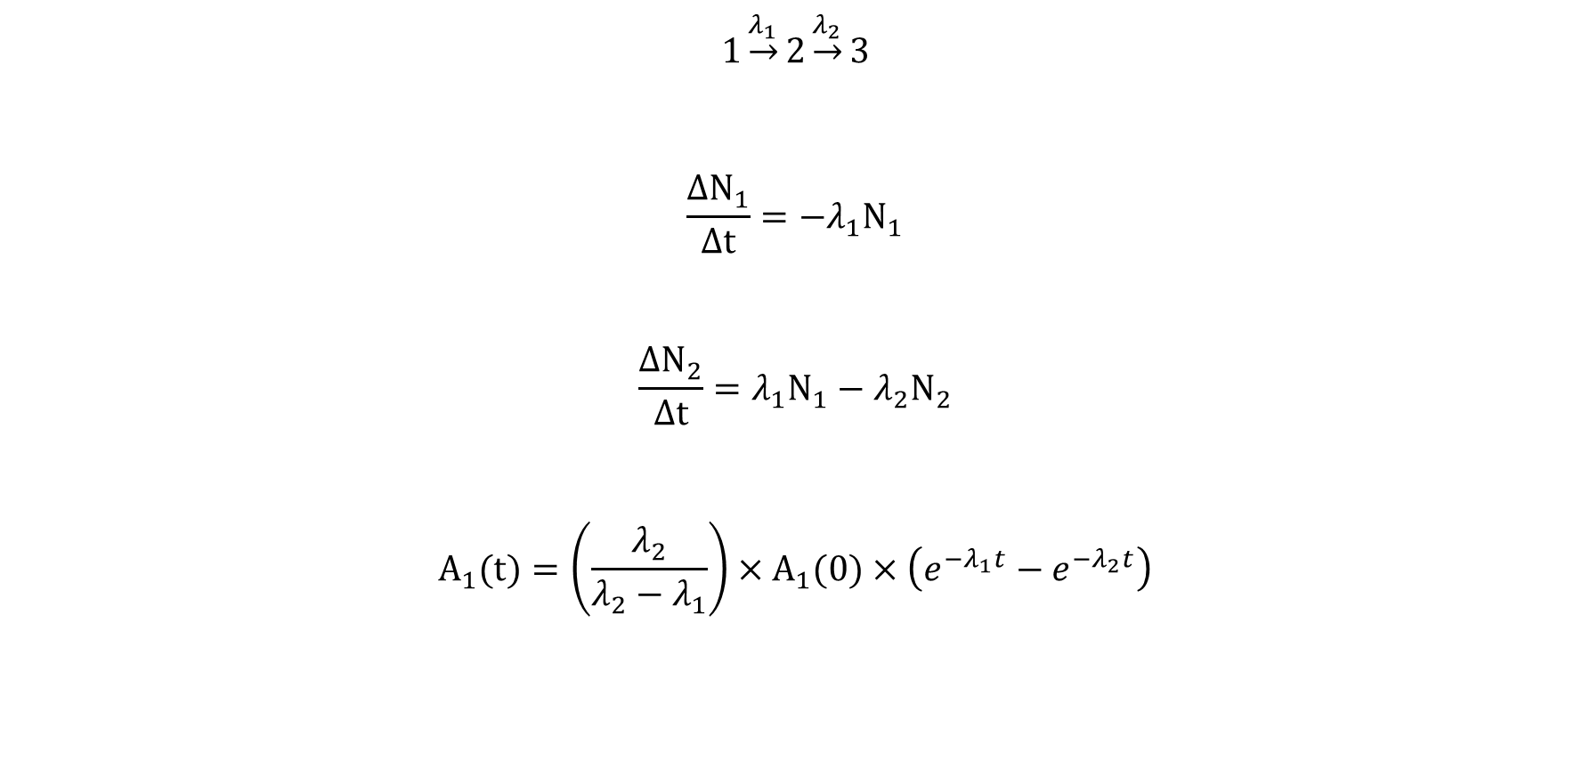
Daughter Activity Equation
$$1\underset{→}{λ_{1}}2\underset{→}{λ_{2}}3$$
$$\frac{ΔN_{1}}{Δt}=−λ_{1}N_{1}$$
$$\frac{ΔN_{2}}{Δt}=λ_{1}N_{1}−λ_{2}N_{2}$$
$$A_{1}(t)=\left(\frac{λ_{2}}{λ_{2}−λ_{1}}\right)×A_{1}(0)×\left(e^{−λ_{1}t}−e^{−λ_{2}t}\right)$$

Slide 15

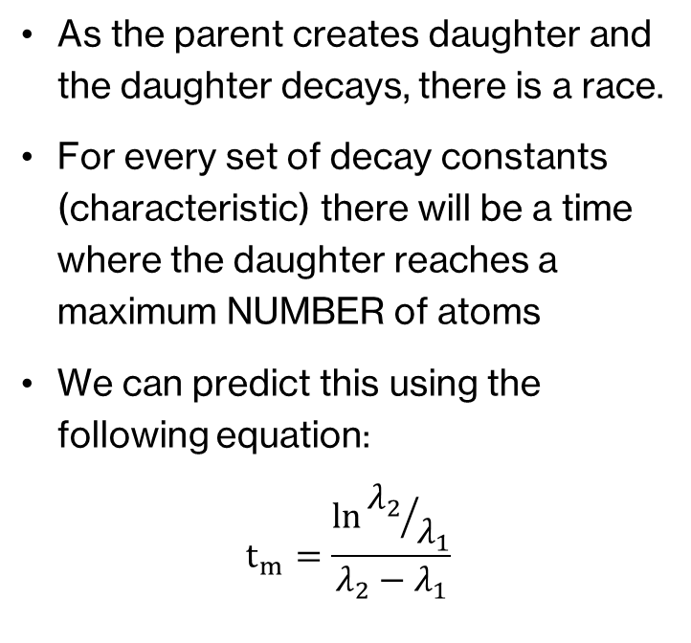
Time to Maximum Daughter Activity
As the parent creates daughter and the daughter decays, there is a race.
For every set of decay constants (characteristic) there will be a time where the daughter reaches a maximum NUMBER of atoms
We can predict this using the following equation:
$$t_{m}=\frac{\ln{{λ_{2}}/{λ_{1}}}}{λ_{2}−λ_{1}}$$

